Slide 1
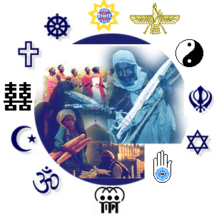
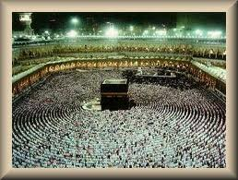
Beyond Space & Time
Islam
The Ka’bah

Slide 2
Beyond Space & Time
Islamic Tradition
Built by Adam
Rebuilt by Abraham & his son Ishmael are being destroyed in the waters of the Flood
Local tribes made annual pilgrimages to the shrine which contained more than 300 statuettes representing the local gods

Slide 3
Beyond Space & Time
Islamic Tradition
In 630 Muhammad returned to his native town after a decade as governor of Medina
Ordered all statuettes to be destroyed.
Ka’bah was retained and transformed into the centre of a new religious world.

Slide 4
Beyond Space & Time
What questions does this raise?
What are they all facing?
With what symbol did Muhammad replace the hundreds of pre-existing pagan statues inside the Ka’bah?

Slide 5
Beyond Space & Time
The answer?
NOTHING
In the heart of Islam lies an indivisible and invisible mystery.

Slide 6
Beyond Space & Time
Muhammad’s action of destroying the statues reflects the first key theological principle concerning the nature fo God in Islam.
It is a principle succinctly expressed in the shahadah – the first of the Five Pillars of Islam:
I bear witness that there is no god but God;
I bear witness that Muhammad is His prophet.

Slide 7
Beyond Space & Time
Shahadah announces
Oneness & uniqueness of God

Slide 8
Beyond Space & Time
Alongside the Jewish faith, Islam stands as a resolute voice of unqualified monotheism, asserting that there is only one absolute and that is by nature undifferentiated and without equal.
Gwynne, Paul (2009) World Religions in Practice p. 33

Slide 10
Beyond Space & Time
610 CE – mediating in a cave on Mt Hira Muhammad was overwhelmed by the presence of another …

Slide 11
Beyond Space & Time
Muhammad
Turning point
Experiences continued for 22 years
Fear & confusion
Continuing nature of the revelation was the evidence that he was being called to be a prophet

Slide 12
Beyond Space & Time
Collected together the recitations became the holiest text in Islam –
The Qur’an

Slide 13
Beyond Space & Time
The Qur’an
A collection of recitations.
Muhammad was commanded to read or to recite

Slide 14
Beyond Space & Time
The Qur’an
114 surahs or chapter
About the size of the New Testament

Slide 15
Beyond Space & Time
Muhammad was virtually illiterate … impossible for him to have produced such an exquisite and profound literary masterpiece without divine involvement.

Slide 16
Beyond Space & Time
Process:
Muhammad “heard”
Muhammad “recited” the divine words
Followers memorised them
Eventually noted them down on parchment, stone, palm leaves & papyrus

Slide 17
Beyond Space & Time
Probably the first written Qur’an was commissioned around the year 650 CE

Slide 18
Beyond Space & Time
Lots of ‘versions’ existed prior to 650. This commissioned edition – during the reign of Uthman – is essentially the version used today.

Slide 19
Beyond Space & Time
Muhammad – not the original author of the words – he was a conduit through which God transmitted a divine message.

Slide 20
Beyond Space & Time
Muhammad did not see God or hear God’s voice. Muhammad heard the voice of the Angel Gabriel.

Slide 21
Beyond Space & Time
In the Semitic religions, Gabriel and he fellow angelic beings bridge the gap between the infinite God and the finite persons, assisting in the process of divine communication.

